Slide 1



UNIVERSITY INSTITUTE OF ENGINEERING
COMPUTER SCIENCE ENGINEERING
Bachelor of Engineering
Design and Analysis of Algorithms(CST-302/ITT-302)
Prepared By: Amrita Chaudhary (E8745)
Topic: Matrix Chain Multiplication
DISCOVER . LEARN . EMPOWER

Slide 2
Learning Objectives & Outcomes
Objective:
To understand the concept of Matrix Chain Multiplication using dynamic programming
Outcome:
Student will understand
Matrix Chain Multiplication using dynamic programming.

Slide 3
Matrix Chain Multiplication
It is a Method under Dynamic Programming in which previous output is taken as input for next.
Here, Chain means one matrix's column is equal to the second matrix's row [always].
In general:
  If A = ⌊a_{ij}⌋ is a p x q matrix
  B = ⌊b_{ij}⌋ is a q x r matrix
  C = ⌊c_{ij}⌋ is a p x r matrix
  Then

Slide 4
Example
Let us have 3 matrices, A₁,A₂,A₃ of order (10 x 100), (100 x 5) and (5 x 50) respectively.
Three Matrices can be multiplied in two ways:
  A₁,(A₂,A₃): First multiplying(A₂ and A₃) then multiplying and resultant withA₁.
  (A₁,A₂),A₃: First multiplying(A₁ and A₂) then multiplying and resultant withA₃.
No of Scalar multiplication in Case 1 will be:
(100 x 5 x 50) + (10 x 100 x 50) = 25000 + 50000 = 75000
No of Scalar multiplication in Case 2 will be:
(100 x 10 x 5) + (10 x 5 x 50) = 5000 + 2500 = 7500

Slide 5
Number of ways for parenthesizing the matrices:
There are very large numbers of ways of parenthesizing these matrices. If there are n items, there are (n-1) ways in which the outer most pair of parenthesis can place.
(A₁) (A₂,A₃,A₄,................A_{n})
Or (A₁,A₂) (A₃,A₄ .................A_{n})
Or (A₁,A₂,A₃) (A₄ ...............A_{n})
........................
Or(A₁,A₂,A₃.............A_{n-1}) (A_{n})
It can be observed that after splitting the kth matrices, we are left with two parenthesized sequence of matrices: one consist 'k' matrices and another consist 'n-k' matrices.

Slide 6
Development of Dynamic Programming Algorithm
Characterize the structure of an optimal solution.
Define the value of an optimal solution recursively.
Compute the value of an optimal solution in a bottom-up fashion.
Construct the optimal solution from the computed information.

Slide 7
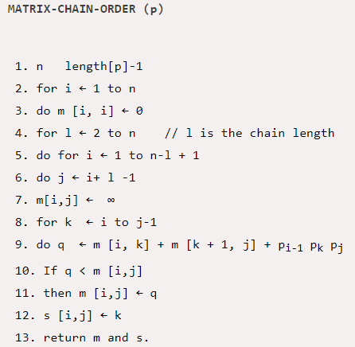
Algorithm

Slide 8
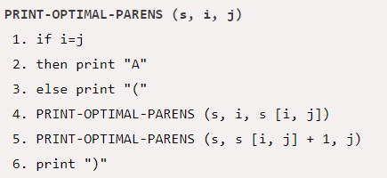

Slide 9
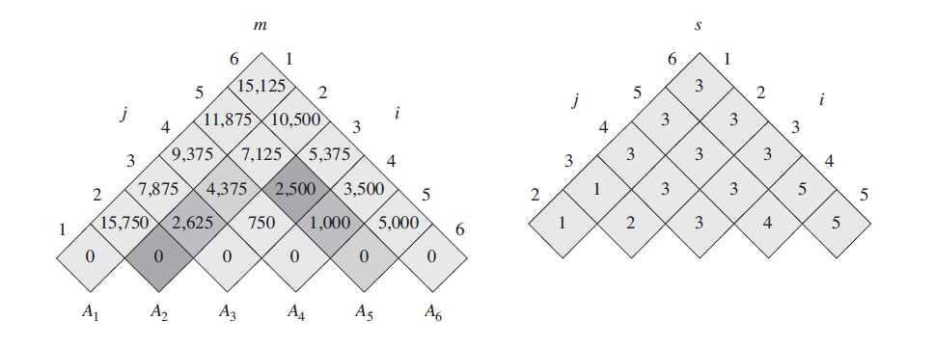
Example

Slide 10
REFERENCES
Text books:
Cormen, Leiserson, Rivest, Stein, “Introduction to Algorithms”, Prentice Hall of India, 3rd edition 2012. problem, Graph coloring.
Websites:
https://www.javatpoint.com/matrix-chain-multiplication-example

Slide 11
Summary
  Dynamic programming:
  Matrix Chain Multiplication

Slide 12
THANK YOU

